Slide 1
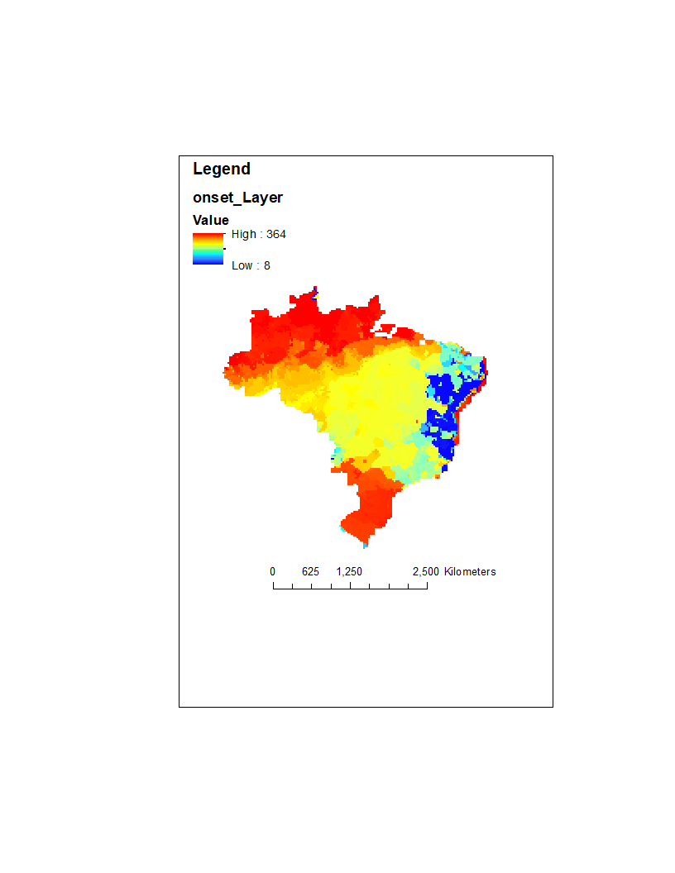
If this is for 2010… DOY starts on Jan 1, 2010?
Dec 2010?
Jan 2011?
Oct 2010?
Dec 2010?

